Slide 1
Climate change
An in-depth look at making rational choices in usage of Volatile Anaesthetics
Dr Priyankar sarkar
Blk-max hospital
New delhi

Slide 2
For
Examples of extreme weather events
Why anaesthesiologists should look to adapt their practice to climate change
Pls go through PPT titled ‘climate change and VAs part I’

Slide 3

All Volatile Anaesthetics (VA) are variably potent Greenhouse gases (GHG)
GHG contributes to the greenhouse effect, a warming of Earth’s surface and troposphere
Atmospheric gas becomes a GHG by absorbing & reflecting infrared radiation IR from Earth that would otherwise escape into space
Properties which determine the potency of a gas as GHG
1. atmospheric lifetime (AL) of gas eg. N₂O
2. % of IR the gas absorbs during its atmospheric lifetime
3. No. of naturally occurring species which absorbs the same wavelength of IR. Less the number more potent the GHG eg Volatile Anaesthetics

Slide 4
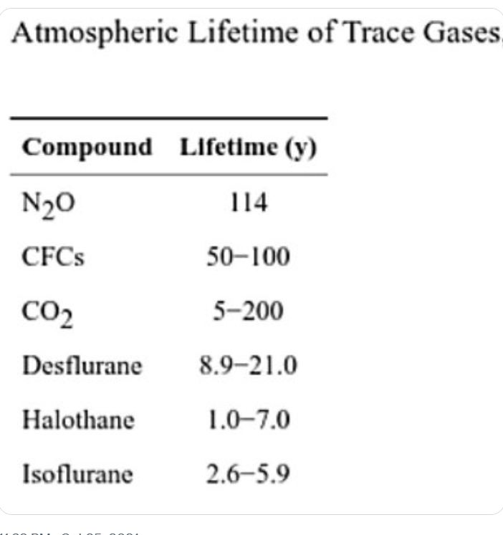
If calculations are based on this table→ erroneous interpretation that VAs do not impact near term climate as much as CFCs and methane
Anaesthetists are operating at the front end of the VA emission curve
Notes:
The use of volatile anesthetics has steadily increased over the past few decades and this is expected to continue in the coming years— especially in the developing world because access to healthcare is increasing. Thus, with continuous output, anesthesiologists are operating at the front end of the curve

Slide 5
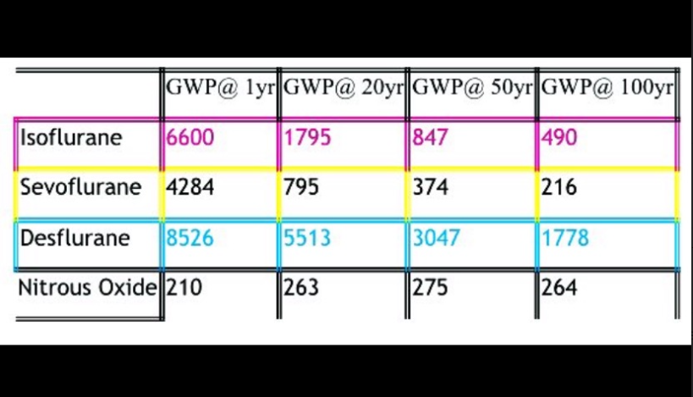
Global warming potential GWP of VA

Slide 6

Most commonly used metric to measure the environmental impact of GHGs is global warming potential GWP
GWP calculates how much heat a GHG/VA will trap in the earth’s atmosphere over a time period (100 yrs) compared with a reference gas ie carbon dioxide (Kyoto protocol)
Concentration of a GHG decreases in the atmosphere over time, so the GWP also declines
GWP of Sevo is 1/7th that of Des at 20 years and 1/8th that of Des at 100 years
Warming potential of Desflurane is much greater that Sevoflurane

Slide 7
Look at the numbers of Sevoflurane and Desflurane at 20 yrs with respect to 1 year. There is 81% decline of sevoflurane and only 35% decline of GWP of desflurane.
Warming potential of Desflurane is much greater that Sevoflurane &
The difference remains constant after 20 years lifetime in the atmosphere

Slide 8
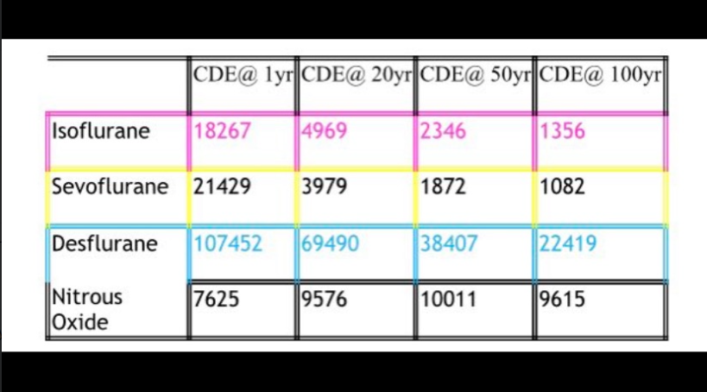
Carbon dioxide equivalent CDE of VA

Slide 9
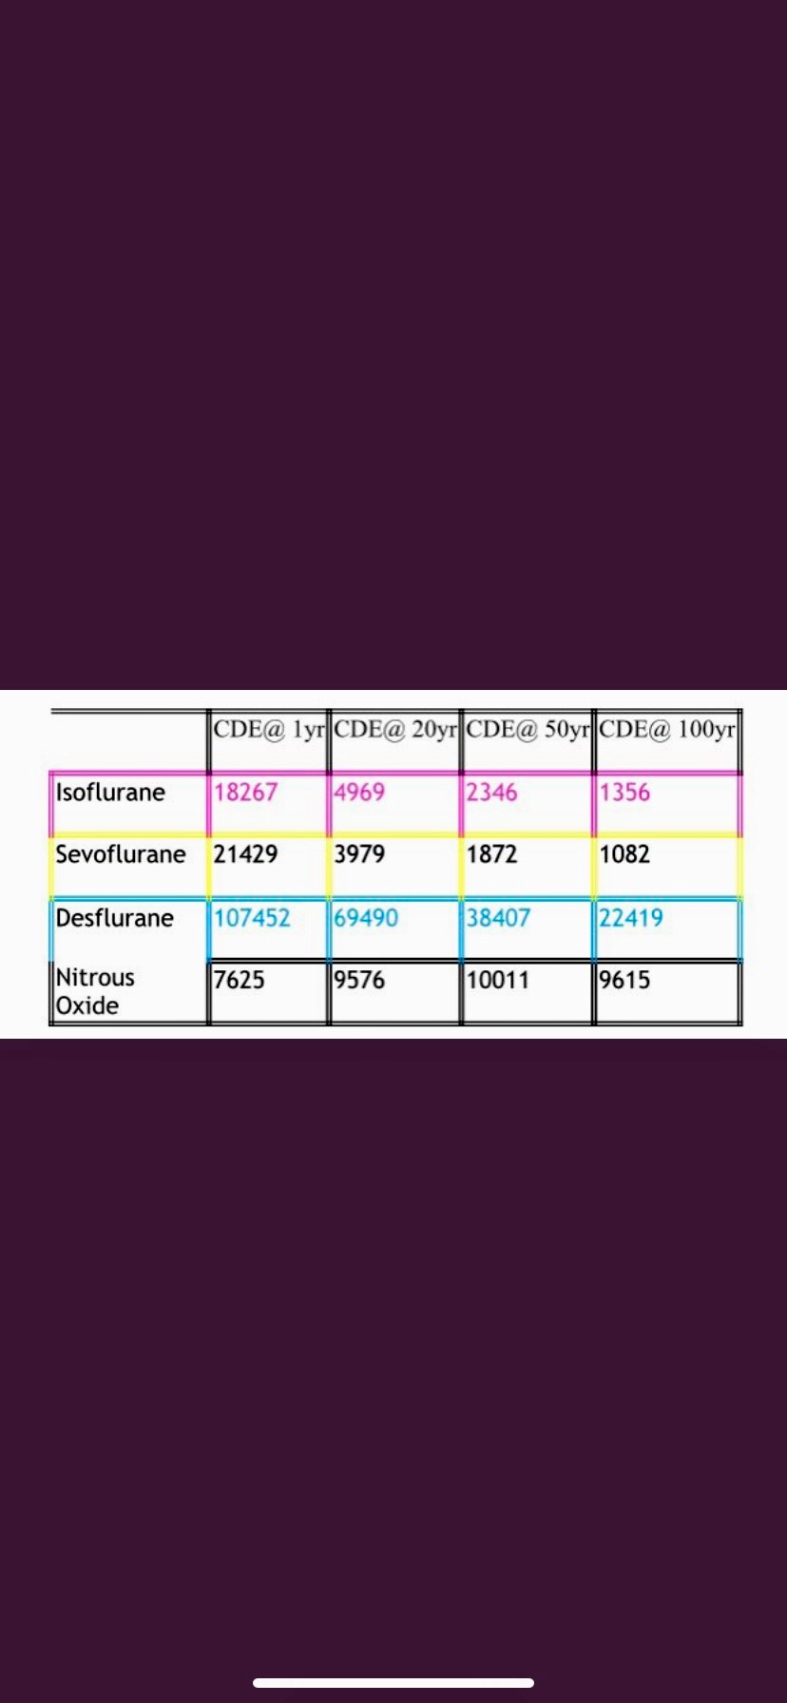
Does N₂O have a lower GWP?
Calculation of actual carbon footprint of each agent requires conversion to equivalent amount of CO₂ CDE
CDE of N₂O surpasses Isoflurane & sevoflurane after 10 years and keeps on increasing
2nd highest after desflurane
CDE of Iso and Sevo, high initially, decreases substantially after 20 years as their Atmospheric Lifetime is approx. 5 years
CDE of desflurane is
5 times of sevo at 1 year
17 times at 20 years
20 times at 100 years
With the gap ever widening
Notes:
N₂O is a stock pollutant… it accumulates slowly and its effect is felt for decades
A flow pollutant has a short lifetime, so if the amount released remains constant, the pollution created will remain constant at the level of release. A stock pollutant has a long lifetime and will thus cumulate with ongoing release. All three volatile agents are flow pollutants. Looking at their 100-year impact is essentially downplaying their impact in the near future. Rather look at the GWP @1y
For calculations in above table see reference
Ref: The future is now-it's time to rethink the application of the Global Warming Potential to anesthesia, Ozelsel et al 2019

Slide 10
Does N₂O have a lower GWP?
N₂O is a stock pollutant… it accumulates slowly and its effect is felt for decades
A flow pollutant has a short lifetime, so if the amount released remains constant, the pollution created will remain constant at the level of release.
A stock pollutant has a long lifetime and will thus cumulate with ongoing release
Despite the lower GWP of N₂O, its effect remains constant at a high level due to accumulation as shown in next slide

Slide 11
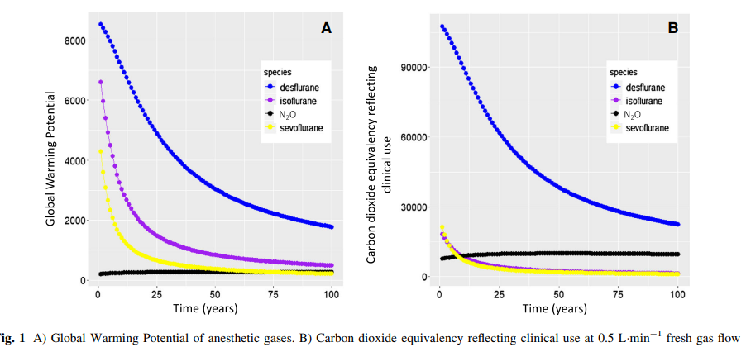
From the curves, it is apparent that GWP values for sevoflurane and isoflurane are very close and look to have approximately similar impact over time, while desflurane has by far the largest impact of all inhalational agents (Fig. 1a). This is even more apparent when comparing CDE in clinically used dosing (Fig. 1b). Nitrous oxide becomes and remains the second most impactful
Notes:
GWP can be used at 20y and 100y; however seeing the impact of a gas over a longer time period is better aided by a curve which makes it easier to identify an agent with a longer impact

Slide 12
Every bottle of desflurane adds significantly more heat to our planet
amount of heat absorbed by the planet after emission of one bottle of
Desflurane Sevoflurane
in first 20 years 998 gigajoules 1790kg of CO₂ vs 579 kg of CO₂
100 years 1315 gigajoules 510kg of CO₂ 161 kg of CO₂
Utilising desflurane in minimal flow for 2000 hours annually, consuming 175 bottles, results in 313,000 kg of CO₂e emissions

Slide 13
MacNeill AJ, Lillywhite R, Brown CJ. The impact of surgery on global climate: a carbon footprinting study of operating theatres in three health systems. Lancet Planet
Health 2017
study comparing the ORs of one hospital each in Canada, USA, and UK
anaesthesia could have greater CO2e emissions than all surgical equipment and OR-associated energy
including from heating, ventilation, and air conditioning if desflurane is used;
if desflurane is not used (UK hospital), then 84% CO2e emissions arose from HVAC, 12% surgical equipment, and
only 4% from anaesthetic gases
VAs can make up 50% of perioperative services carbon emissions
Notes:
None of these hospitals used N20
Ceasing desflurane and N2O use would have the greatest effect in reducing the OR’s carbon footprint

Slide 14
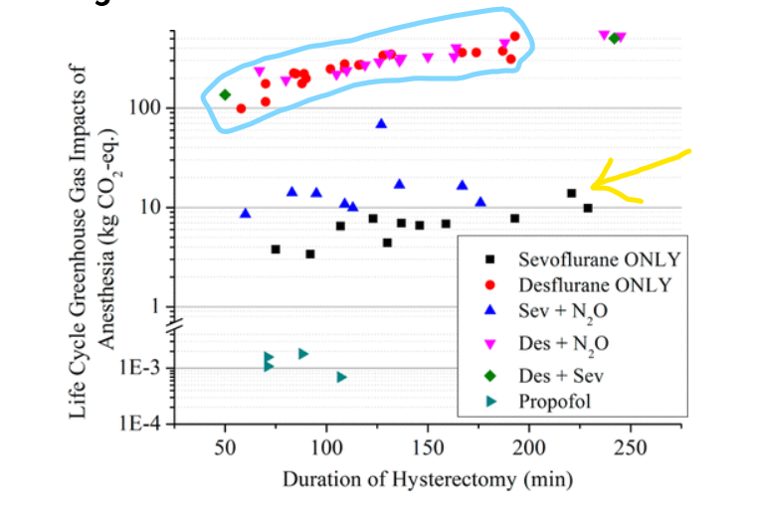
Environmental Impacts of Surgical Procedures: Life Cycle Assessment of Hysterectomy in the United States link and statement below
Environmental Science & Technology 2015 49 (3), 1779-1786
Notes:
4 different approaches to same Sx– vaginal hysterectomy, abdominal hysterectomy, laparoscopic hysterectomy and robotic hysterectomy
Environmental Impacts of Surgical Procedures: Life Cycle Assessment of Hysterectomy in the United States | Environmental Science & Technology (acs.org)
This is an unofficial adaptation of an article that appeared in an ACS publication. ACS has not endorsed the content of this adaptation or the context of its use.

Slide 15
In reference to previous graph
Previous graph shows, irrespective of modality of surgery (laparoscopic/ robotic)
Desflurane (with or without N₂O)has the highest impact in term of CDE
(blue oval at top of graph)
Sevoflurane with N₂O has the 2nd most CDE
Sevoflurane alone is below that

Slide 16

Triple bottomline 3P—people planet profit
Triple bottom line is a sustainability framework revolving around 3 Ps
People
Planet
Profit
Without compromising level of care for our
patients (“people”)
if we are able to contribute to a
better planet and less global warming
WE should do it

Slide 17
Clinically Desflurane & sevoflurane provide same conditions to patients under general anaesthesia→
Desflurane should be used for specific cases only
In comparison to Sevoflurane, Desflurane is consistently associated with
More rapid emergence from anaesthesia
Earlier tracheal extubation
Earlier response to commands post extubation
However
incidence of PONV is same
PACU discharge times are same
Postoperative pain scores are the same
Notes:
References overleaf

Slide 18
references
Zucco L, Santer P, Levy N, et al. A comparison of postoperative respiratory complications associated with the use of desflurane and sevoflurane: a single-centre cohort study. Anaesthesia 2020
Gupta A, Stierer T, Zuckerman R, Sakima N, Parker SD, Fleisher LA. Comparison of recovery profile after ambulatory anesthesia with propofol, isoflurane, sevoflurane and desflurane: a systematic review. Anesth Analg 2004; 98: 623e41
Macario A, Dexter F, Lubarsky D. Meta-analysis of trials comparing postoperative recovery after anesthesia with sevoflurane or desflurane. Am J Health Syst Pharm 2005; 62: 63e8
Liu FH, Cherng YG, Chen SY, et al. Postoperative recovery after anesthesia in morbidly obese patients: a systematic review and meta-analysis of randomized controlled trials. Can J Anesth 2015; 62: 907e17
Stevanovic A, Rossaint R, Fritz HG, et al. Airway reactions and emergence times in general laryngeal mask airway anaesthesia: a meta-analysis. Eur J Anaesthesiol 2015; 32: 106e16
Guo J, Jin X, Wang H, et al. Emergence and recovery characteristics of five common anesthetics in pediatric anesthesia: a network meta-analysis. Mol Neurobiol 2017; 54: 4353e64

Slide 19

Evaluating the risk benefit associated with Desflurane
Since level of care is not affected if sevoflurane is used
Since sevoflurane is more cost-effective than desflurane
Since desflurane has a much higher CO₂e
People Profit Planet
So the Triple Bottomline is in favor of Sevoflurane

Slide 20
Comparison of Volatile Anaesthetic usage for 2 hr steady state simulation in 40 yr old 80kg male patient, breathing system volume 8 L
 | DesF | DesF | DesF | SevoF | SevoF | SevoF
Fresh gas flow Litre/min | 2.0 | 1.0 | 0.5 | 2.0 | 1.0 | 0.5
Consumption ml | 84 | 48 | 29 | 39 | 24 | 16
CO₂e (grams) | 315 | 178 | 109 | 7.8 | 4.7 | 3.1
CO₂e (gram/min) | 2.6 | 1.4 | 0.9 | 0.07 | 0.04 | 0.03
Cost (Rupees) (approx.) | 2400 | 1300 | 800 | 850 | 500 | 350
Notes:
The emitted CO₂ was calculated according to Ryan et al. using the latest GWP100 values of the inhalational anesthetics and for 1 MAC hour
References
1. Rübsam ML, Kruse P, Dietzler Y, Kropf M, Bette B, Zarbock A, Kim SC, Hönemann C. A call for immediate climate action in anesthesiology: routine use of minimal or metabolic fresh gas flow reduces our ecological footprint. Can J Anaesth. 2023 Mar;70(3):301-312. doi: 10.1007/s12630-022-02393-z
2. Sulbaek Andersen MP, Nielsen OJ, Wallington TJ, Karpichev B, Sander SP. Medical intelligence article: assessing the impact on global climate from general anesthetic gases. Anesth Analg. 2012;114:1081–1085. doi: 10.1213/ane.0b013e31824d6150

Slide 21
The table shows the lower carbon footprint of sevoflurane and lower cost vis-à-vis desflurane across all flows and therefore makes a strong case for use of desflurane & nitrous oxide in specific clinically indicated cases

Slide 22
References
1. Varughese S, Ahmed R. Environmental and Occupational Considerations of Anesthesia: A Narrative Review and Update. Anesth Analg. 2021 Oct 1;133(4):826-835. doi: 10.1213/ANE.0000000000005504
2. Campbell M, Pierce JMT. Atmospheric science, anaesthesia and the environment. BJA education 15 (4): 173–179 (2015). doi: 10.1093/bjaceaccp/mku033
3. Özelsel TJ, Sondekoppam RV, Buro K. The future is now-it's time to rethink the application of the Global Warming Potential to anesthesia. Can J Anaesth. 2019 Nov;66(11):1291-1295. doi: 10.1007/s12630-019-01385-w. Epub 2019 May 8
4. Sherman J, Le C, Lamers V, Eckelman M. Life cycle greenhouse gas emissions of anesthetic drugs. Anesth Analg. 2012 May;114(5):1086-90. doi: 10.1213/ANE.0b013e31824f6940. Epub 2012 Apr 4
5. Devlin-Hegedus JA, McGain F, Harris RD, Sherman JD. Action guidance for addressing pollution from inhalational anaesthetics. Anaesthesia. 2022 Sep;77(9):1023-1029. doi: 10.1111/anae.15785. Epub 2022 Jun 21. PMID: 35729804; PMCID: PMC9543086
6. Sulbaek Andersen MP, Nielsen OJ, Wallington TJ, Karpichev B, Sander SP. Medical intelligence article: assessing the impact on global climate from general anesthetic gases. Anesth Analg 2012;114:1081-5

Slide 23
7. White SM, Shelton CL, Gelb AW, Lawson C, McGain F, Muret J, Sherman JD; representing the World Federation of Societies of Anaesthesiologists Global Working Group on Environmental Sustainability in Anaesthesia. Principles of environmentally-sustainable anaesthesia: a global consensus statement from the World Federation of Societies of Anaesthesiologists. Anaesthesia. 2022 Feb;77(2):201-212. doi: 10.1111/anae.15598. Epub 2021 Nov 1
8. Shine KP. Climate effect of inhaled anaesthetics. Br J Anaesth. 2010 Dec;105(6):731-3. doi: 10.1093/bja/aeq313. Erratum in: Br J Anaesth. 2011 Feb;106(2):288. PMID: 21081682.
9. MacNeill AJ, Lillywhite R, Brown CJ. The impact of surgery on global climate: a carbon footprinting study of operating theatres in three health systems. Lancet Planet Health. 2017 Dec;1(9):e381-e388. doi: 10.1016/S2542-5196(17)30162-6
10. McGain F, Muret J, Lawson C, Sherman JD. Environmental sustainability in anaesthesia and critical care. Br J Anaesth. 2020 Nov;125(5):680-692. doi: 10.1016/j.bja.2020.06.055
11. Shelton CL, McBain SC, Mortimer F, White SM. A new role for anaesthetists in environmentally-sustainable healthcare. Anaesthesia. 2019 Sep;74(9):1091-1094. doi: 10.1111/anae.14647
12. Peter-Paul Pichler et al 2019 Environ. Res. Lett. 14 064004

Slide 24
13. Thiel CL, Eckelman M, Guido R, Huddlestome M, Landis AE, Sherman J et al. Environmental impacts of surgical procedures: life cycle assessment of hysterectomy in the United States. Environ Sci Technol. 2015 Feb 3: 49(3); 1779-86
14. Rubsam ML, Kruse P, Dietzler Y, Kropf M, Bette B, Zarbock A, Kim SC, Honemann C. A call for immediate climate action in anesthesiology: routine use of minimal or metabolic fresh gas flow reduces our ecologic footprint. Can J Anaesth. 2023 Mar;70(3):301-12

Slide 25
Thank you
Dr Priyankar Sarkar
ISA Noida GBN Branch (isanoidagbnagar.com)

